Slide 1
Affirming Care - Meeting the Cultural Needs of Youth in Care

Slide 2
Table of Contents
What Is A Transcultural Foster Home
Transcultural Foster Care
Cultural Identity
How to Honor and Support Your Youths Culture
Racism in the Foster Care System
1984
History
Currently
How to Educate your youth
VISIT
SHINRIN-YOKU
FOREST

Slide 3
What is a transcultural foster home?
A transracial placement is when a youth is placed in the care of a foster or adoptive family that is of a different ethnicity from them.
Historically, it has been common for a black or dual heritage youth to be placed with a white family.
Culture has been defined in many ways, sometimes interchangeably with diversity and multiculturalism. Generally, culture entails “those elements of a people’s history, tradition, values, and social organization that become implicitly or explicitly meaningful to the participants … in cross-cultural encounters” . It encompasses “the customs, habits, skills, technology, arts, values, ideology, science, and religious and political behavior of a group of people”

Slide 4
The English Poor Law, lead to development and eventual regulation of family foster care in the United States. In 1562, these laws allowed the placement of poor youth into foster care until they came of age.
In 1853, Charles Loring Brace began the free foster. Brace was concerned about the large number of immigrant youth sleeping in the streets of New York. He devised a plan to provide them homes by advertising in the South and West for families willing to provide free homes for these youth, whether for charitable reasons or whatever help these youth could be to them.
In the 1970s and 1980s, the scarcity of African American foster families and the disproportionate numbers of African American youth in foster care (US DHHS, 2002) were the impetus behind new legislation regarding transracial foster and adoptive placements.
The Adoption Assistance and youth Welfare Act of 1980 was to ensure that youth in foster care were placed in homes as the result of a thoughtful planning process we now know as permanency planning.
In 1998, of the 560,000 youth in foster care, 34% were Caucasian, 44% were African American, 15% were Hispanic, 2% were Native American, 1% were Asian, and 4% was unknown.
Transcultural Foster Care: History

Slide 5
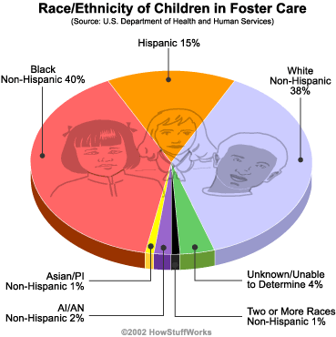
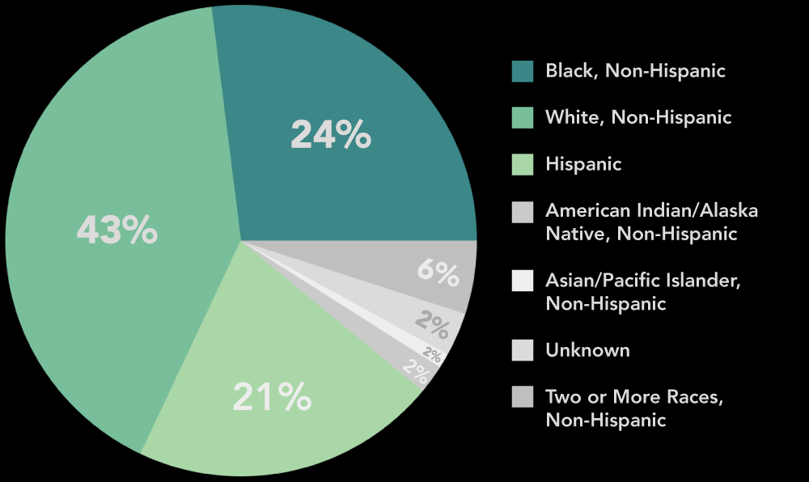
Given the increased number of youth from racialized groups requiring foster care and the decreasing number of foster parents from racialized groups, transcultural foster placements are on the rise. Addressing racial and cultural diversities within the context of transcultural foster care placements is one of the most pressing dilemmas of contemporary youth protection practice.
Ethnicity of foster parents in the foster system.
Transcultural Foster Care: Currently

Slide 6
Cultural Identity
Strong cultural identity contributes to mental health resilience, higher levels of social well-being, and improved coping skills, among other benefits. Foster youth face and deal with trauma, changing home environments, and lower levels of social well-being than the general population. Often, due to this disruption, former foster youth have lower cultural identity strength than those who did not experience foster care. youth welfare practitioners must examine how they can best support strong cultural identity in foster youth.
A 2015 study showed 20% of foster youth changed their ethnic identity when asked how they identified over a five-year period, which is twice as high as non-foster youth. Additionally, ethnic identity is most often mismatched between how youth self identify, how the county identifies them, and how the school has classified them. The study notes the problem of having weak cultural identity and underscores the need to increase fundamental support for youth to maintain a strong identity, for “ethnic identity is essential for promoting youth well-being and success. The mismatch of ethnic identity between the youth and the bureaucracy that guides them leads to missed resources or missed opportunities to educate foster parents on how best to support the youth.
Over 60% of youth in foster care have psychiatric disorders including depression and anxiety.[9] While there are many contributing factors to mental health, strong cultural identity helps the youth deal with adverse experiences and transitions and can reduce depression and anxiety.

Slide 7
Youth Unlimited, Inc.
Bring. Give. Share.
How to Honor and Support Your Youth’s Culture
Educate Yourself: Take out books from the library, explore websites, learn new recipes specific to your youth’s place of birth. In addition, you can explore the cuisines, holidays, celebrations, language and traditions. If you have friends from that culture, ask them questions about their favorite traditions and cultural themes, attend their religious services, meetings, etc. Finally, if you have other youth, require them to learn this too. Have fun with it! It will be a great way to bring your family closer together.
Don’t Force It: Remember your youth is working hard to learn a new environment, enjoy new foods, and adapt to new routines. They may not want to seem different or stand out in any way, especially during their school years. Consequently, they may not want to talk about or focus on their culture and heritage during certain times. Later, they may want to explore more information about their homeland and culture. Being flexible and understanding of what your youth’s needs and wants are as they grow regarding their culture and heritage will make their journey easier.
Be Positive and Open: When working with Youth in their teenage years, they will begin to integrate their life experiences into developing their own sense of identity. Most importantly, with a positive and open home environment where they are free to explore their own culture and heritage, they will be able to incorporate a well rounded, and proud sense of themselves as they transition into young adulthood.

Slide 8
Racism in the Foster Care System
Professionals in the foster care system routinely contend that Native American and African American youth are the most at-risk for youth abuse and neglect, a presumption currently reflected in the system.
The nation's poorest youth, not surprisingly, make up most of the foster care population. African Americans and Native Americans are disproportionately poor, and that correlation increases the probability of foster care for these races.
A 2016 report from the youth’s Bureau at the U.S. Department of Health and Human Services, African Americans are represented in foster care at 1.8 times their rate in the population. A higher percentage of the Black population is placed in foster care than the white population, and Black youth spend longer on average in foster care than white youth.
Today, with all our data and cultural competency training, Black families are more likely to be reported to the youth abuse hotline and investigated for youth abuse and neglect. Before youth welfare is even involved, the Black family is suspect. In the foster care system, White saviorism still influences youth welfare practice.

Slide 9
Talking To Your Youth About Race
Have a Conversation – we use the word conversation intentionally because after this conversation has been had, understand that it’s forever developing, and the door must remain open for you to be a supportive parent and ally. Youth learn from experiences and observation, the way you move, react to situations, is how they see fit to react. As parents and caregivers, we need to acknowledge our youth are becoming less protected as they grow and need to understand the world outside of their homes. That includes how you act in response to situations.
Let them embrace their diversity and learn from those living it every day. Let them see in their own family their color is respected, honored, and each member values their input and are open to being educated about their culture and lived experiences. It’s also important to work against the negative that harms them by being an ally and let them never guess if you are standing with them.
Understand although the wounds may heal, the scar is left. Coping is ongoing until there is a radical change and acceptance this is and will be an emotional weight your youth and you have to carry.

