Slide 1
Give. Bring. Share.
Suicide Prevention

Slide 2
Table of Contents
Suicide Prevention
1984
Suicide Risk of Foster Youth
Signs A Youth Is Suicidal
Suicide Prevention
What Can You Do To Prevent Suicide
On Call Crisis Support Schedule
VISIT
Suicide Risk Screening Tool
YUI Crisis Protocol
Watch Log
SHINRIN-YOKU
FOREST

Slide 3
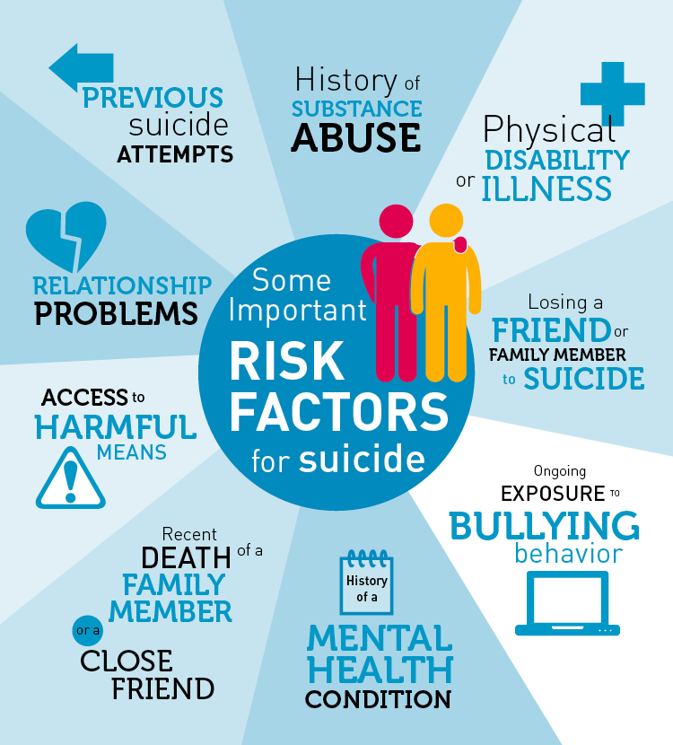
Suicide Risks for Foster Youth
Suicide is the second leading cause of death among the nation’s teenagers
In one study, youth in foster care were almost three times more likely to have considered suicide and almost four times more likely to have attempted suicide than those who had never been in foster care
Suicide rates are much higher among American Indian/Alaska Native (AI/AN) youth than among youth overall.

Slide 4
Signs a Youth Is Suicidal
Excessive sadness or moodiness
Sudden calmness
Withdrawal
Changes in personality and/or appearance
Dangerous or self-harmful behavior
Recent trauma or life crisis
Preparing
Threatening suicide
https://www.youtube.com/watch?v=odGRP9TtT7E
http://www.nami.org/Learn-More/Know-the-Warning-Signs
Notes:
Excessive sadness or moodiness: Long-lasting sadness and mood swings can be symptoms of depression, a major risk factor for suicide.
Sudden calmness: Suddenly becoming calm after a period of depression or moodiness.
Withdrawal: Choosing to be alone and avoiding friends or social activities also are possible symptoms of depression.
Changes in personality and/or appearance: A person who is considering suicide might exhibit a change in attitude or behavior, such as speaking or moving with unusual speed or slowness. In addition, the person might suddenly become less concerned about his or her personal appearance.
Dangerous or self-harmful behavior: Potentially dangerous behavior, such as reckless driving, engaging in unsafe sex and increased use of drugs and/or alcohol.
Recent trauma or life crisis: A major life crisis might trigger a suicide attempt.
Preparing: Often, a person considering suicide will begin to put his or her personal business in order.
Threatening suicide: Not everyone who is considering suicide will say so, and not everyone who threatens suicide will follow through with it. However, every threat of suicide should be taken seriously.

Slide 5
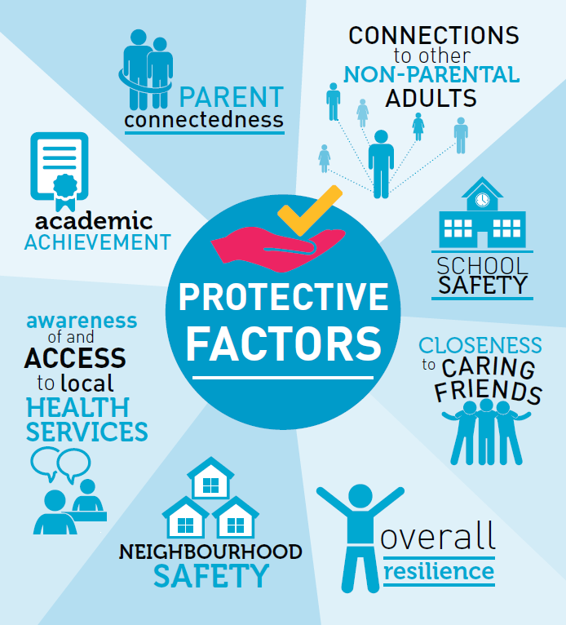
Suicide Prevention: Protective Factors
https://www.youtube.com/watch?v=3BByqa7bhto
youth who have experienced or are at risk for maltreatment, trauma, and/or exposure to violence can be a highly vulnerable population, however;
Protective Factors: characteristics or conditions that reduce or buffer the effects of risk, stress, or trauma. A protective factor is an asset of some kind.
Notes:
Example of Protective Factor: A skill, personal attribute, or supportive relationship, Community connectedness, and easy access to effective medial and mental health services.
Benefits: Protective factors are key intervention strategies that can improve the outcomes of social and emotional well-being in youth and youth.

Slide 6
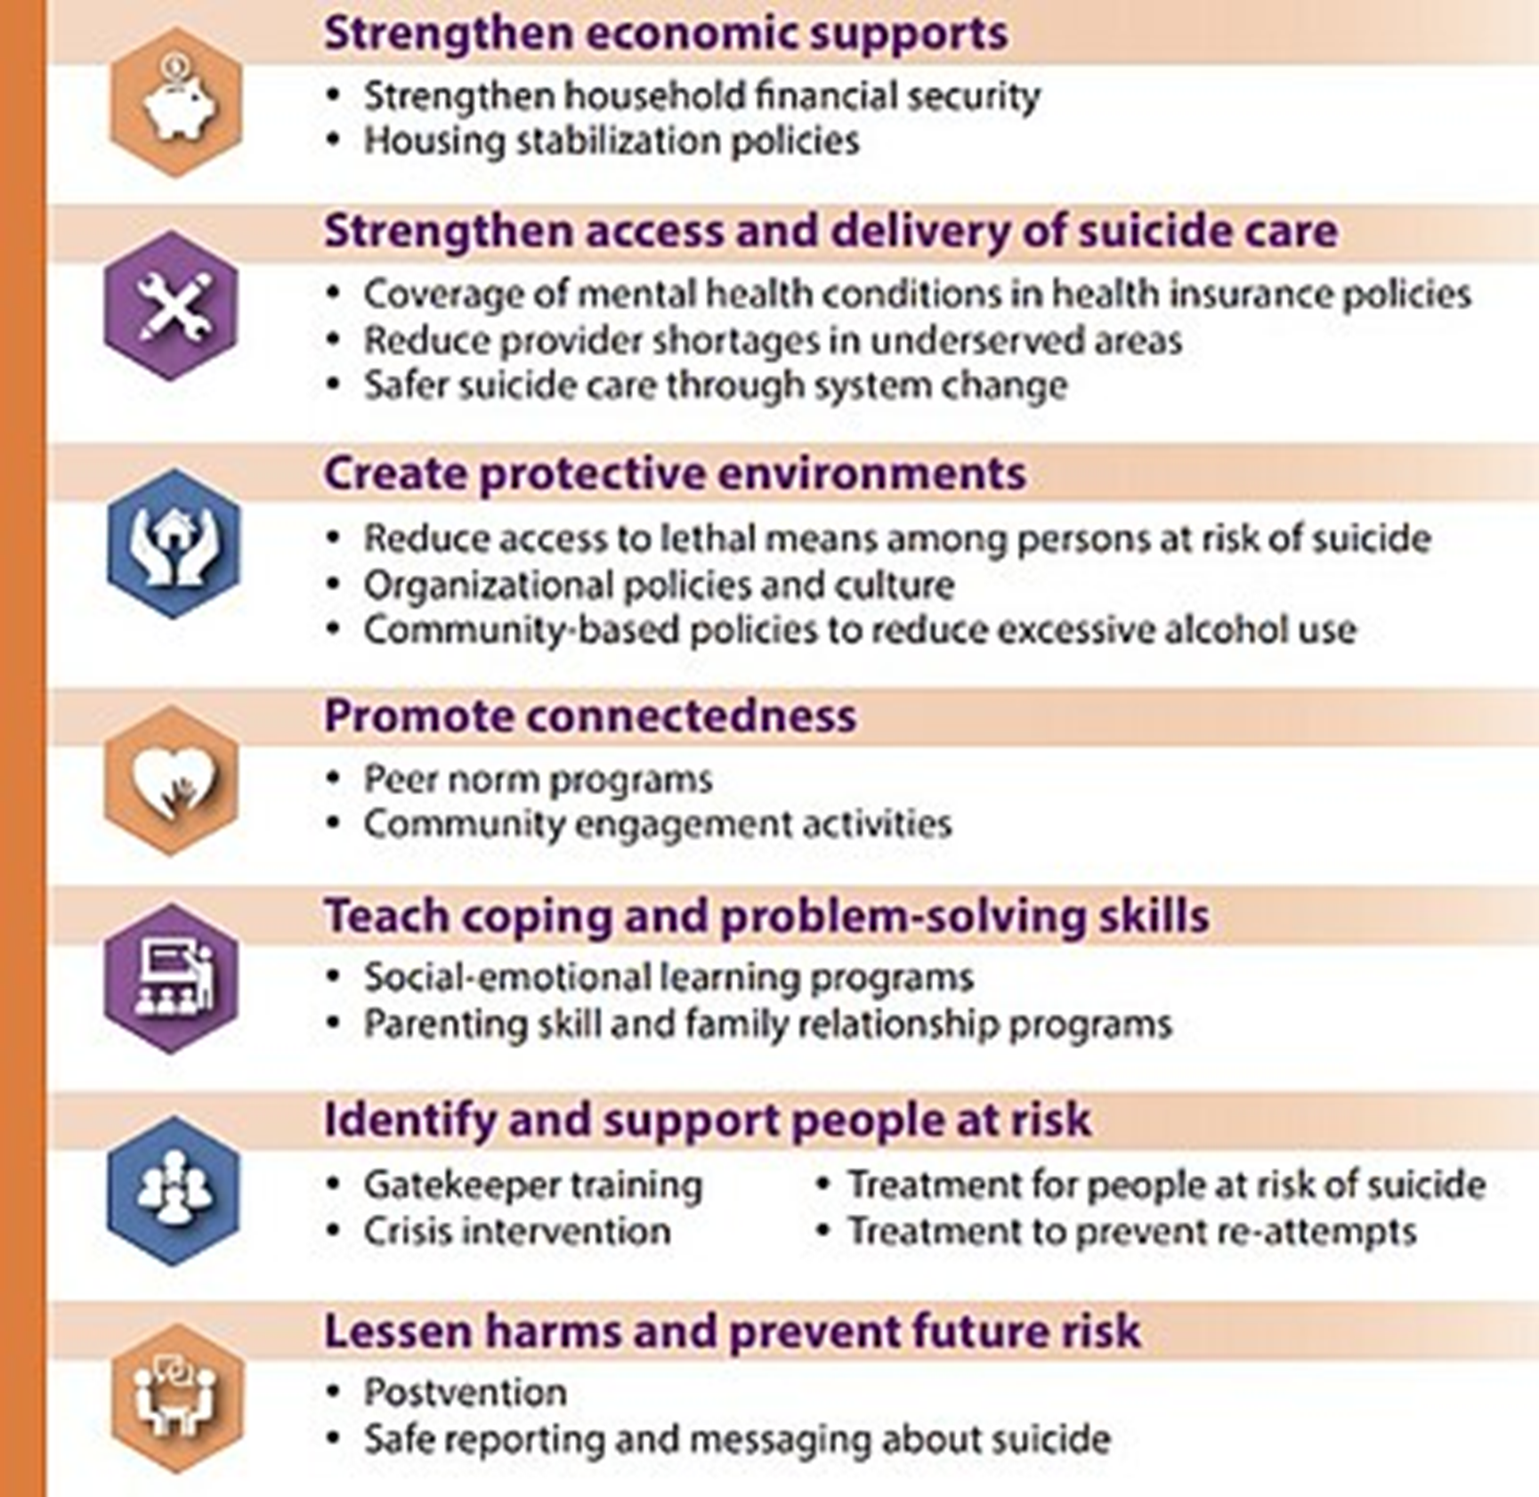
Prevention
What Can You Do To Prevent Suicide
Five things you can do
Ask someone you are worried about if they're thinking about suicide. (While people may be hesitant to ask, research shows this is helpful.)
Keep them safe. Reduce access to lethal means for those at risk.
Be there with them. Listen to what they need.
Help them connect with ongoing support.
Stay connected. Follow up to see how they’re doing
Notes:
If youth Foster Youth Mentions they are considering suicide, listen and take their concerns seriously. Don't be afraid to ask questions about their plans. Let them know you care, and they are not alone. Help them to access help immediately from a knowledgeable professional. Don't leave them alone.

Slide 7
On Call Crisis Support
On-Call Crisis Support
Please contact the YUI staff that is on-call for any crisis support that you need. Reasons to call crisis are any situation you feel unsafe, when you feel the youth is unsafe, when the youth reports feeling unsafe, when the youth is escalated and not responding to your de-escalation tactics, the youth needs immediate medical care, the youth ran away, the youth has threatened to hurt themselves or someone in the home.
THE ON-CALL PHONE NUMBER IS ALWAYS THE SAME: 503-676-7251

Slide 8
On-call Crisis Support
YUI Crisis Response Protocol
Reasons to call the YUI crisis staff
Youth is not responding to foster parents de-escalation techniques.
Youth has threatened foster parent or foster siblings
Youth has expressed suicidal or self-harm thoughts
The youth has self-harmed or had a Suicide attempt
Youth has reported abuse or neglect
If the youth has damaged property
If the youth talked about running away or if the youth has run away
If you have questions or concerns
Work with on-call staff to come up with an immediate safety plan.
Emergency Safety Plans are intended to help the youth get through until a permanent plan is created.
Plans may include
completing a suicide risk assessment
Sweeping a youth ’s room of sharps and other self-harm objects
Watch log
Removing youth’s jackets, shoes, and backpacks (run risk)
Follow up
Write and IR
If directed foster parents may need to follow up with one or more of the following agencies
Police—911
the national hotline for missing and exploited children 1-800-THE-LOST (1-800-843-5678).
Multnomah county mental health line 503-988-4888
National youth crisis hotline 800-442-hope (4673)
Oregon Child Protective Services 1-855-503-SAFE (7233)
The youth's case manager will follow up with foster parents and youth the next day to talk about the crisis and come up with a permanent safety plan.

Slide 9
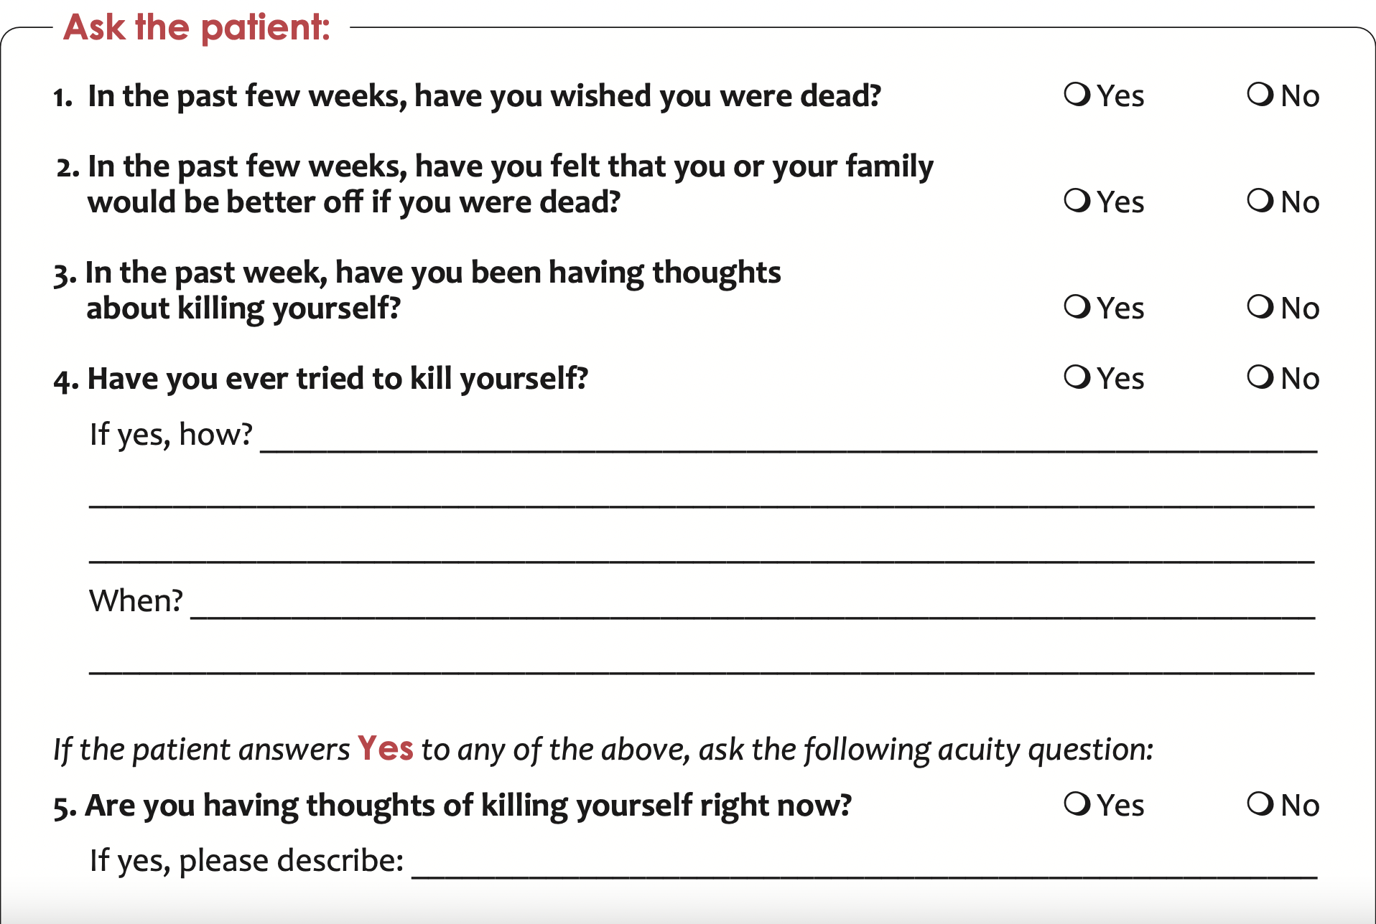
The National Institute of Mental Health has created a
tool that is a standard for suicide risk screening.
The top section is to assess the level of risk, and the bottom section identifies next steps if the assessment reveals a positive screen for suicidality.
If the assessment reveals a positive screen, emergency protocols are initiated.
Suicide Risk Screening Tool
suicide risk screening tool.pdf

Slide 10
Crisis Intervention Strategies
Safety Watch Log
A Safety Watch Log is a tool is often utilized during times when a youth is in acute crisis such as suicidality, self-harming behaviors, or risk of running away.
A Safety Watch is increased sight and sound supervision at intervals that best fit the assessment of risk.
YUI staff or foster parents can initiate a Safety Watch; however, a YUI staff will determine, with consultation, when the Safety Watch is no longer needed. Always communicate with a YUI staff if a Safety Watch is initiated.
The Safety Watch Log is the documentation that shows proof of our responsiveness to a youth’s needs.

