Slide 1
Give. Bring. Share.
HIPPA Requirements

Slide 2
Table of Content
What Is HIPAA
Covered Entities Under HIPAA
HIPAA Privacy Rule
Protected Health Information
HIPAA Compliance
HIPAA Violations
What Foster Parents Need To Do
Discussion

Slide 3
What is HIPAA
HIPAA is the United States Health Insurance Portability and Accountability Act of 1996. The HIPAA Privacy Rule provides protections for individually identifiable health information held by covered entities and their business associates and gives individuals rights with respect to that information.
Any electronic, paper or oral health information that can identify a specific client is Protected Health Information (PHI). This includes:
Information that relates to an individual’s past, present or future physical or mental health condition
Information about the provision of healthcare to the individual
Information regarding payment for the individual’s healthcare
Notes:
YOUTH UNLIMITED INC. employees are expected to understand the law
To follow it in day-to-day work activities and to respect our clients’ privacy and confidentiality.

Slide 4
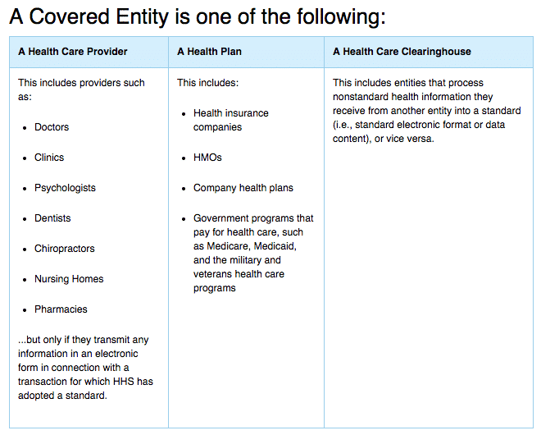
Covered Entities Under HIPAA
Covered entities under HIPAA:
People who are responsible for transporting documents.
Transactions:
Healthcare Claims & Status
Payment
Eligibility checks
Referral Cert. & Authorization
1984
VISIT
SHINRIN-YOKU
FOREST
Notes:
Covered entities under HIPAA are individuals or entities that transmit protected health information for transactions for which the Department of Health and Human Services has adopted standards
Transactions include transmission of healthcare claims, payment and remittance advice, healthcare status, coordination of benefits, enrollment and disenrollment, eligibility checks, healthcare electronic fund transfers, and referral certification and authorization

Slide 5
Honoring our youth’s information
HIPAA’s Privacy Rule:
Confidentiality
Establishes safeguards for the protection of Protected Health Information (PHI)
Holds violators accountable
Gives clients more control over their PHI
Informs clients of their rights and our responsibilities for protecting PHI
Gives clients the right to inspect and obtain a copy of their own health record and request amendments
Limits the release of PHI to the minimum needed for the purpose of the disclosure
Notes:
Gives clients the right to request communications in a confidential or restricted manner
Gives clients the right to request an accounting of certain disclosures for purposes other than treatment, payment, healthcare operations or without authorization

Slide 6
Protected Health Information
Confidentiality
HIPAA defines Protected Health Information (PHI) as any health-related information combined with a unique identifier that matches a particular individual.
Identifiers include, but are not limited to:
Date of birth
Address
Social security number
Email address
Phone number
If the data can be used to identify a patient, it should be considered as a possible identifier and treated as Protected Health Information (PHI).
Notes:
Consider other data elements that could be an identifier (and therefore Protected Health Information) which are often overlooked:
MAC address of the network card on a device
P address of a device
Drivers license number
Biometric data (fingerprints, retina scans, etc)
Medical record numbers
Medical device serial numbers
Health plan account numbers
Dates of visits, admission, discharge, and treatment
Payments/bills
Photographs
Diagnostic codes

Slide 7
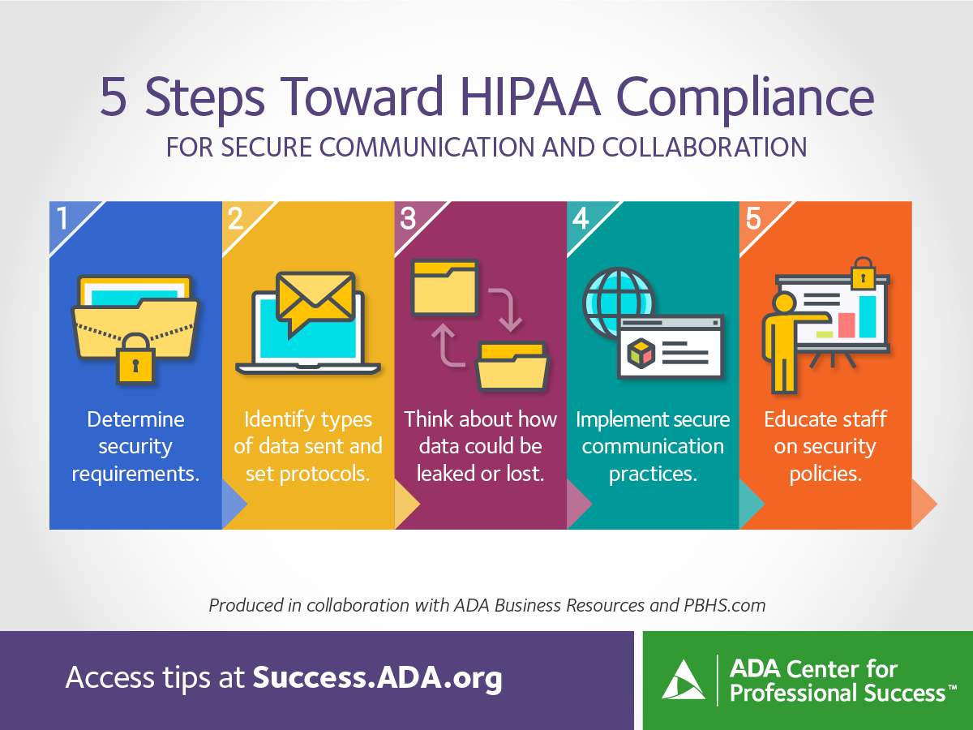
Protocols
HIPAA Compliance

Slide 8
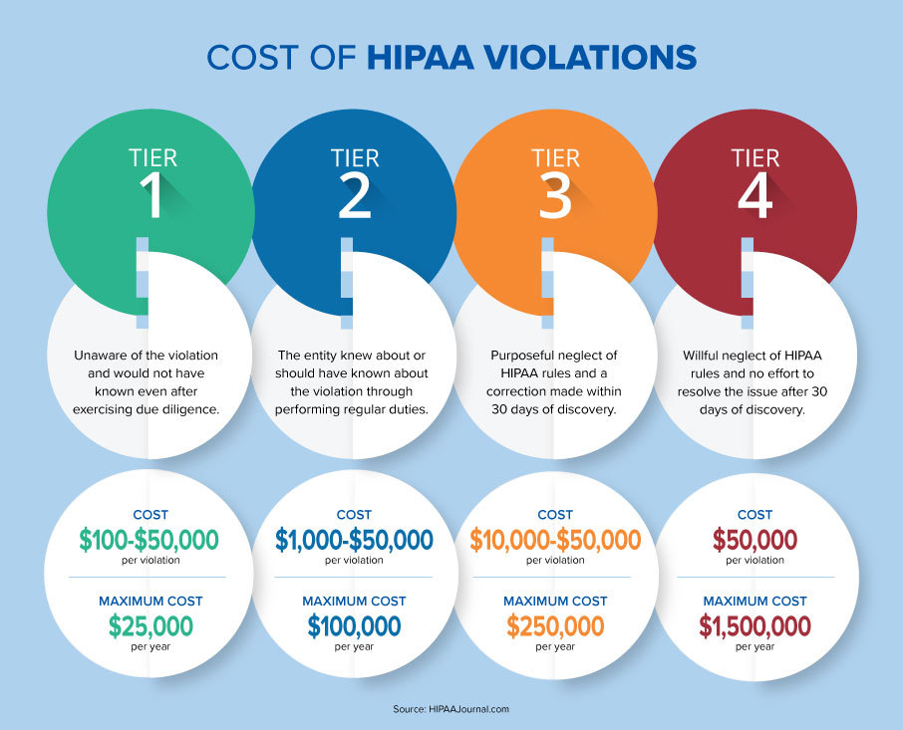
HIPAA Violations
Most Common HIPAA Violations
A non-encrypted lost or stolen device
Lack of employee training
Database breaches
Sharing PHI
Improper disposal of PHI

Slide 9
Compliance
What You Need To Do To Comply With HIPAA
Access PHI only in the course of your work assignments and only the minimum amount needed to perform your job
Lock up PHI when not actively using (Using locking file cabinets, locking file folders and don’t leave materials on desks)
Handle PHI responsibly to avoid any unnecessary disclosure
Discuss PHI only in locations where it cannot be overheard by anyone other than the intended recipient(s)
Dispose of PHI by shredding
Report any unauthorized disclosure to YOUTH UNLIMITED INC. HR within 24 hours.

