Slide 1
Give Bring Share
Positive Behavior Management

Slide 2
Table of Content
What is Positive Behavior Management
Basic Behavior Management
How to Listen
Causes of Challenging Behavior
Consequences
Toolbox
Understanding Temperament
Understanding Behavioral Intervention

Slide 3
What is Positive Behavior Management
In the early 1980’s, there were important advances in the design and application of interventions for challenging behavior.
These advances were driven by research on innovations in approaches for behavior change and shifts in cultural values about the use of aversive and dehumanizing intervention practices with vulnerable populations.
The non-aversive technology that emerged in the late 1980’s and early 1990s for addressing the challenging behaviors of individuals with severe disabilities was referred to as positive behavioral support (PBS).
This approach included the use of functional assessment, antecedent manipulations, teaching strategies, and changes in reinforcement contingencies with a focus on achieving lifestyle changes as the outcome of intervention.

Slide 4
What is Positive Behavior Management
Positive Behavior Management provides a process to understand and resolve the problem behavior of individuals or children that is based on values and empirical research.
It offers an approach to develop an understanding of why the child engages in problem behavior and strategies to prevent the occurrence of problem behavior while teaching the child new skills.
Positive behavior support offers a holistic approach that considers all factors that have an impact on a child and the child’s behavior. It can be used to address problem behaviors that range from aggression, tantrums, and property destruction to social withdrawal.

Slide 5
Basic Behavior Management
Prevent
Change triggers
Recognize prior experiences (e.g. culture)Daily check-in & family forum meetings
Clarify limits & timelines
Clear, positively-stated expectations for behavior
Household routines to support expectations
Have fun together
Relax & destress
Reinforce
‘Have to’ activities then ‘want to’
Establish incentives for prosocial behavior
Daily feedback on behavior (discuss solutions to problems
Catch problems when small
Reward positive behavior 3 times as often as correct problem behavior
Be consistent & follow through (e.g behavior contracts)
Use logical & effective consequences
1984
VISIT
Teach
Teach Communication skills
Model Skills for children
teach connection between school success & future
Teach coping strategies
Teach life skills
Set goals & action plan to transition to independence
Behavior, not the child, is the ‘problem’
Teach problem solving
SHINRIN-YOKU
FOREST

Slide 6
How to Listen
Comprehend what’s said.
Many people aren’t clear communicators, so a good listener must untangle the convolutions.
And even if the speaker is crystalline, some content may be difficult to grasp. Good listeners know when they must listen intently, and when they can get away with listening "with one ear."
And when they don’t understand something important, even if it’s just because their mind wandered, they’re secure enough to ask for a re-explanation: “I didn’t quite get that. Would you mind repeating that?” On hearing such a request, rarely do speakers think, “How dumb.” More likely, they appreciate that someone cared enough to ask for a re-explanation. And usually, the replay is clearer than the original.
Notice important things not said.
For example, on a first date, it can be instructive and revealing if a person talks only about work, not relationships. Are you good at listening for the important unspoken?

Slide 7
How to Listen
Recognize changes in tone and body language.
Good listeners observe baseline behavior:
For example, does the person’s face, voice, and body language appear tense?
If so, a good listener might then try to appear particularly relaxed and non-confrontive.
More important is to note changes from baseline: For example, if the speaker's vocal pitch suddenly rises, what he or she's saying may be emotionally charged. Suddenly crossing his or her arms may indicate defensiveness or dissembling. No such cues are dispositive; they merely alert the good listener. How are you at monitoring the speaker’s face, voice, and body language?
Consciously decide whether to add input.
The good listener is secure enough to rationally decide whether, in any given situation, to add input or to just listen and possibly ask follow-up questions. Don’t let your desire to impress trump what’s best for the interaction and the desired outcome. In the right situation, restraint can be just as compelling. Do you add content to a conversation only when wise?
https://www.youtube.com/watch?v=cSohjlYQI2A&feature=emb_logo

Slide 8
How to Listen Continued
Accurately determine whether to think ahead.
It’s natural to think ahead to what you’ll say next. That’s fine when you’re good at predicting what the person will be saying. Good listeners who have learned from experience that their predictions are too often inaccurate restrain themselves from thinking, or speaking, ahead.
Think before responding.
After the speaker has finished, a good listener may take some time before responding. Simply take a few seconds to think or say, “Give me a second to think about that.” Doing either makes a speaker feel that what they've put forth merits reflection and that the listener wasn’t just waiting until the speaker finished so that he or she can hold forth.
Know when it’s wise to interrupt.
Interrupting imposes a price: It makes the speaker feel invalidated. Let the person talk. And, as a speaker proceeds, he or she relaxes and is more likely to disclose something he or she might not have planned to earlier. Famed jury consultant Jo Ellen Dimitrius and sports agent Leigh Steinberg have both said that interrupting is the worst thing you can do in a negotiation. I’d temper that by saying that, when dealing with long-winded people or when time is short, some interrupting may be justified, especially when you’re confident that you know what the speaker will say or that enduring the speaker’s additional disquisition will likely yield little value or pleasure.
The takeaway
Perhaps it's now clearer that good listening is more difficult than meets the ear. As you look back on your experience, is there at least one thing you’d like to do differently?

Slide 9
How to Listen Continued
Know when it’s wise to interrupt.
Interrupting imposes a price: It makes the speaker feel invalidated. Let the person talk. And, as a speaker proceeds, he or she relaxes and is more likely to disclose something he or she might not have planned to earlier. Famed jury consultant Jo Ellen Dimitrius and sports agent Leigh Steinberg have both said that interrupting is the worst thing you can do in a negotiation. I’d temper that by saying that, when dealing with long-winded people or when time is short, some interrupting may be justified, especially when you’re confident that you know what the speaker will say or that enduring the speaker’s additional disquisition will likely yield little value or pleasure.
The takeaway
Perhaps it's now clearer that good listening is more difficult than meets the ear. As you look back on your experience, is there at least one thing you’d like to do differently?

Slide 10
Causes of Challenging Behavior
Behavior refers to how a person conducts themselves to their reaction, actions, and functioning in response to everyday situations and different environments.
Challenging behavior is a termed used to describe behavior that interferes with a person’s daily life. Challenging behavior also describe behavior that is challenging to everyone who support the person to understand why it is happening and find solution.

Slide 11
Causes of Challenging behaviors
Feeling unwell or in pain. It may be difficult to communicate this to others. Head banging is a way of coping with the pain or discomfort.
Hormonal changes may cause aggression during puberty.
Frustration at being told off, not being listened to or not being understood. Self-harm can be a way of communicating this frustration.
Feeling upset or distressed about something, perhaps a change in routine. Or even loneliness.
Depression, anxiety or even excitement. Hand biting may help them to cope with these feelings.
Boredom or lack of stimulation may lead to skin picking.
Lack of understanding. For example, what’s edible or inedible, or what’s the correct way to wipe themselves on the toilet.
Sensory needs. Exploring how things feel or smell, like faces.
Seeking attention. Wanting a reaction or avoiding a demand.
Fear of where they are or what they’re doing.

Slide 12
Non-permitted Consequences
The following interventions are prohibited in all licensed homes and facilities:
Corporal punishment of any kind. Examples of corporal punishment include but are not limited to: spanking with a hand or object, biting, jerking, kicking, shaking, pulling hair, or throwing the child;
Behavioral control methods that interfere with the child’s right to humane care. Examples of methods which interfere with humane care include but are not limited to: deprivation of sleep, providing inadequate food, purposely inflicting pain as a punishment, name-calling or using derogatory comments, verbal abuse, or actions intended to humiliate;
Depriving a child of the components of humane care. Examples of the components of humane care include but are not limited to: necessary clothing, personal hygiene, adequate shelter, adequate food, and necessary medical or dental care;
Depriving the child of necessary services. Examples of necessary services include but are not limited to: contact with the assigned social worker, contact with the assigned legal representative, family contacts and/or therapeutic activities which are part of the child’s DCFS Individual Service and Safety Plan (ISSP);
Use of medication in an amount or frequency other than that which has been prescribed by a physician or psychiatrist;
Giving medications that have been prescribed for another person;
Physically locking doors or windows in a way that would prohibit a child from exiting except as described in section VII. E (De-escalation Room with Spring Lock on Door) and section VIII. (Secure Crisis Residential Centers).
Physical restraint techniques which restrict breathing;
Physical restraint techniques that inflict pain as a strategy for behavior control;
Mechanical restraints used as a punishment. See section VII. F (Use of Mechanical Restraints for Safety Reasons Related to Disability or Medical Condition) for description of allowed use of mechanical restraints; and
Any activity that interferes with the child’s basic right to humane care, protection, safety and security.

Slide 13
Permitted Consequences
Foster parents may assign consequences for inappropriate behavior.
When consequences are used, they must be discussed with the child in such a way that they help the child gain self-control skills and encourage the child to make positive behavior choices.
The assigned consequence must not pose additional risk to the child. For example, a foster parent may not make a child spend the night outside because she came home after curfew.
Foster parents assigning a consequence must keep in mind the child’s unique circumstances, history, age, developmental level, mental health issues, and cognitive abilities.
If the chosen consequence isn’t working, adjust it quickly. Do not give up on the behavior plan. Find consequences that are effective.
Examples of consequences that are permitted include:
1. Allowing events to occur which are a natural or logical outcome of the behavior;
Giving a timeout (briefly sending the child to a common area such as a bedroom or a special chair in the living room. Generally, one minute per year of age);
Meetings to discuss the behavior and strategies for change;
Extra chores appropriate for the child’s age and abilities;
Loss of privileges such as television or telephone;
Early bedtime/early curfew;
Time limited restriction from planned recreational activities;
Restricted access to areas generally available to the children in care;
Increased adult supervision;
Temporary removal of personal property used (or threatened to be used) by the child to inflict injury on self or others;
Restricting the child from possessing certain items; and
Searches of personal property for restricted items.

Slide 14
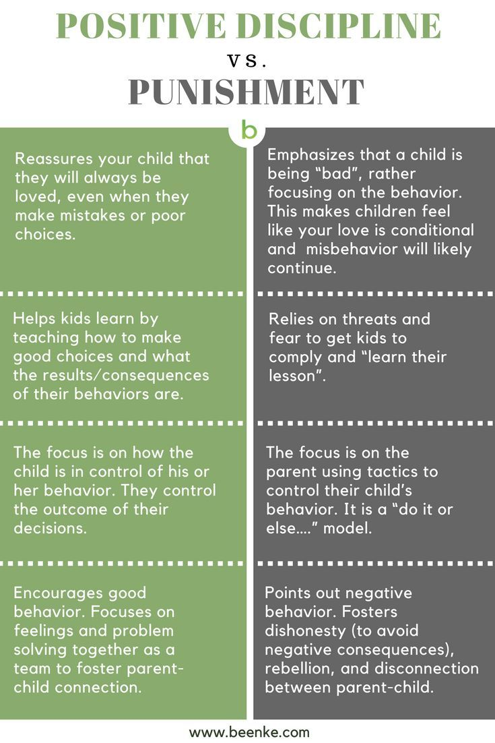
Discipline vs. Punishment

Slide 15
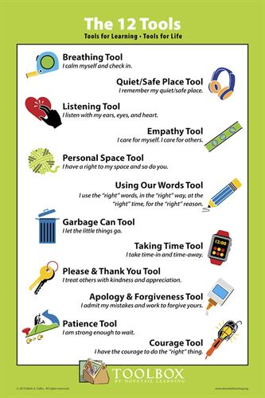
Positive Behavior Management Toolbox

Slide 16
Understanding Temperament
What Is Temperament?
Temperament is a psychological term that incorporates a person’s innate activity level, regularity of basic functions, initial approach to new situations, adaptability, emotional sensitivity, intensity, mood, attention span, distractibility, and the amount of stimulation required for a response. Temperament is the result of genetic factors and is nobody’s fault or responsibility. It is powerfully important in a person’s personality and life experience. A child who needs time to feel comfortable, for example, experiences new situations, like a birthday party, very differently than a child who is happy to jump right in.

Slide 17
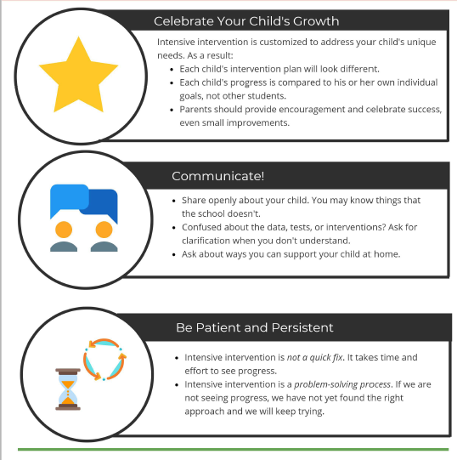
Understanding Behavioral Intervention
One of the core concepts of positive behavioral approaches is that all behavior is an attempt to communicate needs or wants. Another core concept is that there are positive, supportive ways to respond to a behavior that help a child reduce the less desirable behaviors while developing new appropriate skills. Understanding behaviors from a developmental perspective can help us understand both the reason for the behavior and how to help change the behavior.

