Slide 1

Give. Bring. Share.
Collaborative Problem Solving ®

Slide 2
Table of Contents
What is CPS
Core Beliefs of CPS
What are Triggers
Emotional Triggers
Social Thinking Skills
Challenging Behaviors
Assessment Tool
CPS Problem Solving
Plan A
Plan C
Plan B
  Step 1
  Step 2
  Step 3

Slide 3

Why Collaborative Problem Solving®?
Kids will do well if they can
It is a relationship-based model of intervention.
Kids with challenging behavior are tragically misunderstood and mistreated. They don’t lack the will to behave well, rather they lack the skill to behave well.
Conventional approaches, such as reward/punishment don’t work long-term and often make things worse. These methods often rely on extrinsic (external) motivation.
CPS addresses the basic human needs for competency, autonomy and connection, which drive intrinsic (internal) motivation.
When challenging behaviors are reframed and communicated as lagging skills, the research shows that caregiver stress lessens, youth feel more supported, empathy increases, and relationships have a better chance to thrive.
Helping kids with challenging behavior requires understanding why they struggle in the first place.
Watch this video from Dr. Stuart Ablon (90 minutes):
https://www.youtube.com/watch?v=zuoPZkFcLVs.
Notes:
Thankfully, there’s another way. But it requires a big shift in mindset.
Our Collaborative Problem Solving approach recognizes what research has pointed to for years – that kids with challenging behavior are already trying hard. They don’t lack the will to behave well. They lack the skills to behave well

Slide 4
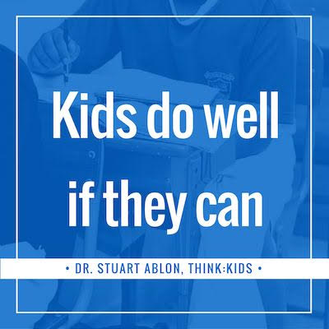
Core Belief of CPS: Kids Do Well If They Can
Children are challenging because they’re lacking the skills not to be challenging; they don’t yet have the crucial cognitive skills such as flexibility, adaptability, frustration tolerance and problem – solving.
CPS helps adults shift to a more accurate and compassionate mindset and embrace the truth that kids do well if they can – rather than the more common belief that kids would do well if they simply wanted to.
CPS focuses on building skills like flexibility, frustration tolerance and problem solving, rather than simply motivating kids to behave better.
1984
VISIT
SHINRIN-YOKU
FOREST
Notes:
The process begins with identifying triggers to a child’s challenging behavior and the specific skills they need help developing. The next step involves partnering with the child to build those skills and develop lasting solutions to problems that work for everyone.
The CPS approach was developed at Massachusetts General Hospital in the #1-ranked Department of Psychiatry in the United States. It is proven to reduce challenging behavior, teach kids the skills they lack, and build relationships with the adults in their lives. If you’re looking for a more accurate, compassionate, and effective approach, you’ve come to the right place. Fortunately, anyone can learn CPS. Let’s get started!

Slide 5
What are Triggers
An emotional trigger is anything — including memories, experiences, or events — that sparks an intense emotional reaction, regardless of your current mood. Emotional trigger can also be a topic that makes us feel uncomfortable.
Common emotional triggers:
    Someone rejecting you.
Someone leaving you (or the threat that they will).
Helplessness over painful situations.
Someone discounting or ignoring you.
Someone being unavailable to you.
Someone giving you a disapproving look.
Someone blaming or shaming you.
The anniversary dates of losses or trauma.
frightening news events.
too much to do, feeling overwhelmed.
family friction.
the end of a relationship.
spending too much time alone.
being judged, criticized, teased, or put down.
financial problems, getting a big bill.
Notes:
These emotional triggers are telling us which aspects in our life we might feel frustrated or unsatisfied with. As mentioned above, it can vary in each person because we are all struggling with something different.

Slide 6
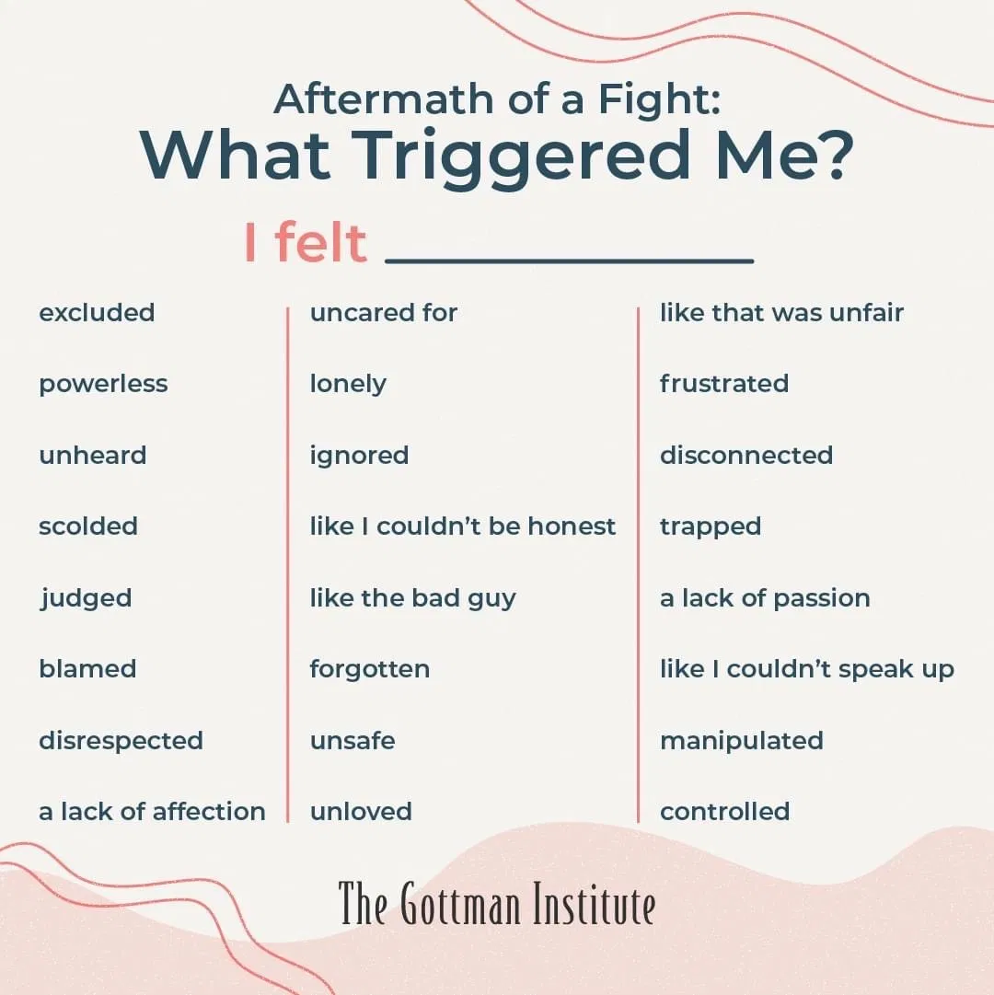
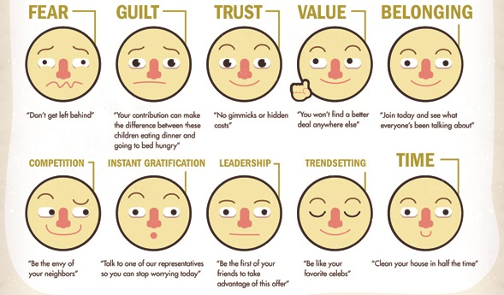
Examples
Emotional Triggers

Slide 7
Social Thinking Skills
Language and Communication Skills
Understands what others are saying
Understands the flow of conversations
Quickly understanding people who are talking
Saying what they are thinking, or what they need
Is able to tell someone what’s bothering them
Saying what they are feeling
Quickly finding the words to use
Emotion- and Self-Regulation Skills
Thinks rationally, even when frustrated
Manages irritability in an age-appropriate way
Manages anxiety in an age-appropriate way
Manages disappointment in an age-appropriate way
Thinks before responding; considers the likely outcomes or consequences of his/her actions
Can adjust his/her arousal level to meet the demands of a situation (e.g., calming after recess or after getting upset, falling asleep/waking up, staying seated during class or meals, etc.)

Slide 8
Social Thinking Skills
Attention and Working Memory Skills
Sticks with tasks requiring sustained attention
Does things in a logical sequence or set order
Keeps track of time; correctly assesses how much time a task will take
Reflects on multiple thoughts or ideas at the same time
Maintains focus during activities
Ignores irrelevant noises, people, or other stimuli; tunes things out when necessary
Considers a range of solutions to a problem

Slide 9
Social Thinking Skills
Cognitive Flexibility Skills
Handles transitions, shifts easily from one task to another
Is able to see “shades of gray” rather than thinking only in “black-and-white”
Thinks hypothetically, is able to envision different possibilities
Handles deviations from rules, routines, and original plans
Handles unpredictability, ambiguity, uncertainty, and novelty
Can shift away from an original idea, solution, or plan
Takes into account situational factors that may mean a change in plans (Example: “If it rains, we may need to cancel the trip.”)
Interprets information accurately/avoids over-generalizing or personalizing (Example: Avoids saying “Everyone’s out to get me,” “Nobody likes me,” “You always blame me,” “It’s not fair,” “I’m stupid,” “Things will never work out for me.”)

Slide 10
Social Thinking Skills
Social Thinking Skills
Pays attention to verbal and nonverbal social cues
Accurately interprets nonverbal social cues (like facial expressions and tone of voice)
Starts conversations with peers, enters groups of peers appropriately
Seeks attention in appropriate ways
Understands how his or her behavior affects other people
Understands how he or she is coming across or being perceived by others
Empathizes with others, appreciates others’ perspectives or points of view

Slide 11
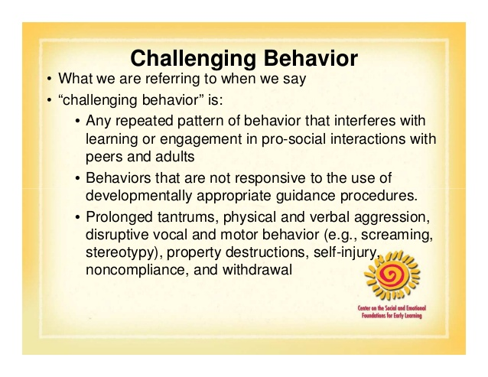
Kids will do well if they can
Challenging Behaviors
Challenging behavior is any behavior that someone displays that is a challenge for others to manage and/or puts the young person or others at risk.
Examples of common challenging behavior:
Aggression (e.g., hitting, kicking, biting)
Self-injurious behavior (e.g., head banging, biting self, hitting self)
Shouting/swearing
Sexualized behavior in public
Throwing items/breaking things
Soiling/smearing
Notes:
Many of the young people in the foster care system have lagging skills that present as challenging behaviors.

Slide 12
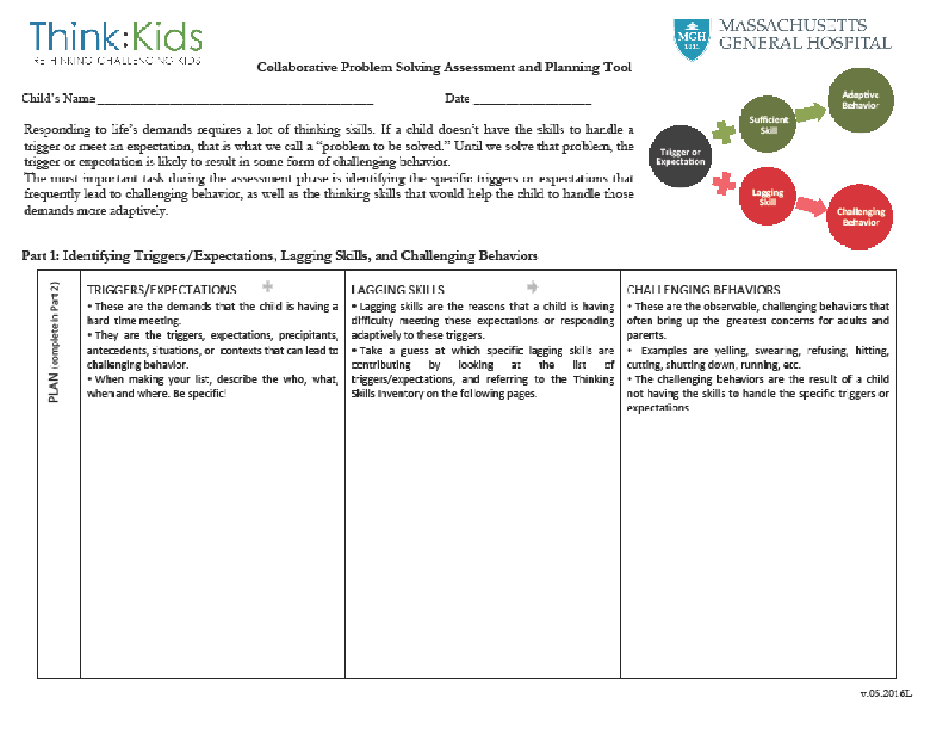

Slide 13
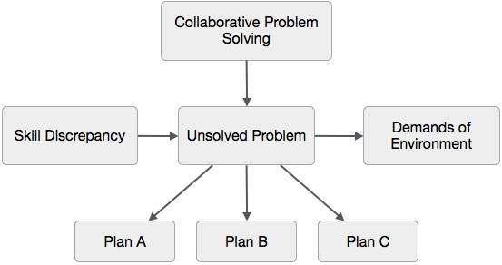

From
Tokyo
with
Love.

Slide 14
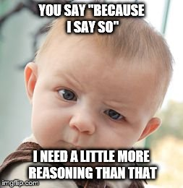
Plan A: Adults Will
Most often, adults try to impose their will to make a child meet their expectations. This is called “Plan A” in CPS.
Having someone else impose their will upon you requires a variety of skills that kids with challenging behaviors lack.
Plan A often increases challenging behaviors, and it does not teach the skills kids lack to meet expectations.
Plan A interferes with the teaching of those skills since it tends to get in the way of developing a helping relationship that is crucial to teaching skills.
Plan A’s are not for “because I say so” situations.
Reasons to use Plan A
For the youth's safety (i.e., removing sharps, removing phone)
For others’ safety (i.e., keeping youth out of the community space, removing weapons)
Notes:
Plan A is necessary because we put expectations in place for the youth's safety, but pursuing those expectations also greatly heightens the likelihood of challenging behavior in challenging kids.

Slide 15
Plan C: dropping an expectation
Kids will do well if they can
Plan C is when the adult drops an expectation, at least for now. A common misconception is that Plan C is “giving in.” Giving in is when adults try to address a problem or unmet expectation using Plan A and then proceed to drop the expectation when they can’t impose their will or the child responds poorly. Plan C, is being strategic. You can’t work on all problems all at once.
Plan C is a way of prioritizing (i.e., treatment planning) and deciding what you want to address first. By putting some problems or unmet expectations on the “back burner” while addressing problems that are of a higher priority, some challenging behaviors are reduced.
Adults are still in charge when using Plan C because they are deciding what to address and what to drop for now.

Slide 16
Plan B: Collaborative Problem Solving
Most problems aren’t solved in a single Plan B discussion, and Plan B usually feels like slogging through mud in the beginning, but the continuous use of Plan B helps solve problems that are precipitating challenging behavior in a durable way while building helping relationships, thinking skills, intrinsic motivation and confidence.
Plan B is the heart of CPS when adults work together with kids to solve problems in mutually satisfactory and realistic ways. Plan B involves four basic steps.
The first step is the Empathy step. In this step you need to gather information from the client in order to understand the child’s concern about the problem to be solved and reassure him or her that imposition of adult will is not how the problem will be resolved.
The second step is to define the problem and to share the adults’ concerns about the same issue.
The third step is the invitation step where the child and adult work together to assess potential solutions and choose one that is both realistic and mutually satisfactory.

Slide 17
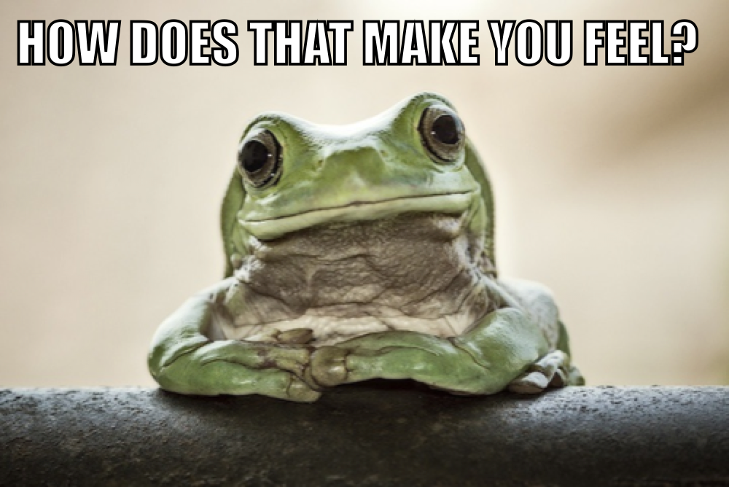
Step 1: Empathy
The empathy step is the most important step in a plan B. The goal is to gather information to get a clear understanding of child's concern or perspective on an unsolved problem.
DRILLING FOR INFORMATION
Usually involves reflective listening and clarifying questions, gathering information related to the who, what, where, and when of the unsolved problem, and asking the kids what they’re thinking in the midst of the unsolved problems and why the problem occurs under some conditions and not others.
MORE HELP
If the kid doesn’t talk or says, “I don’t know”, try to figure out why:
Maybe the unsolved problem wasn’t free of challenging behavior, wasn’t specific, wasn’t free of adult theories, or was "clumped” (instead of split)
Maybe you’re using Emergency Plan B (instead of Proactive Plan B)
Notes:
Maybe you’re using Plan A, Maybe he really doesn’t know, Maybe he needs the problem broken down into its component parts, Maybe he needs time to think

Slide 18
Step 1:
Empathy + Curiosity
WHAT YOU'RE THINKING
“What don’t I yet understand about the kid’s concern or perspective? What doesn’t make sense to me yet? What do I need to ask to understand it better?”
DON’T
Skip the Empathy step
Assume you already know what the kid’s concern is and treat the Empathy step as if it is a formality
Rush through the Empathy step
Leave the empathy step before you completely understand the kid's concern or perception
Talk about solutions yet

Slide 19
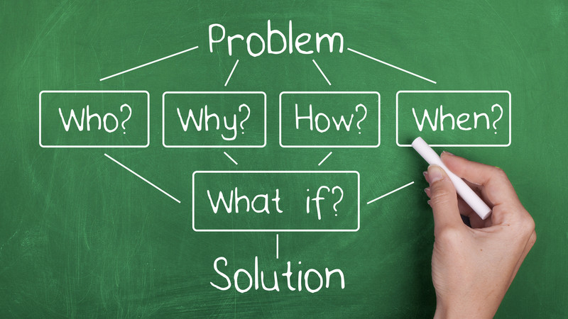
Step 2: Define the Problem
Introduce your concern or perspective about the same unsolved problem. Make sure there are two sets of concerns on the table before you move onto step 3:
The youth’sconcerns
The other's concerns
WORDS | Initial Inquiry (neutral observation)
“The thing is (insert adult concern)….” or “My concern is (insert adult concern)…”

Slide 20
Step 2: Define the Problem
MORE HELP
Most adult concerns fall into one of two categories:
• How the problem is affecting the kid
• How the problem is affecting others
WHAT YOU'RE THINKING
"Have I been clear about my concern? Does the child understand what I have said?”
DON’T
Start talking about solutions yet
Sermonize, judge, lecture, use sarcasm

Slide 21
Step 3: Invitation step
Goal: client and therapist brainstorm realistic solutions that address both concerns. Give a summary of the concerns:
"I wonder if there is a way that (both concerns)...."
Generate solutions that are realistic (meaning both parties can do what they are agreeing to) and mutually satisfactory (meaning the
solution truly addresses the concerns of both parties)
WORDS
Restate the concerns that were identified in the first two steps, usually beginning with “I wonder if there is a way…”
THINKING IT THROUGH:
Does it work for them?
Does it work for others?
Is it doable and realistic?
If we do it, does it bring up any other concerns?
Does the plan require the client to use a skill set they don't have?

Slide 22
Step 3: Invitation step
DON’T
Rush through this step
Enter this step with preordained solutions
Sign off on solutions that both parties can’t perform
Sign off on solutions that don’t truly address the concerns of both parties
MORE HELP
Stick as closely to the concerns that were identified in the first two steps
While it’s a good idea to give the kid the first opportunity to propose a solution, generating solutions is a team effort
It’s a good idea to consider the odds of a given solution working. If you think the odds are below 60-70 percent, consider what it is that’s making you skeptical and talk about it
“Have I summarized both concerns accurately? Have we truly considered whether both parties can do what they’ve agreed to?

Slide 23
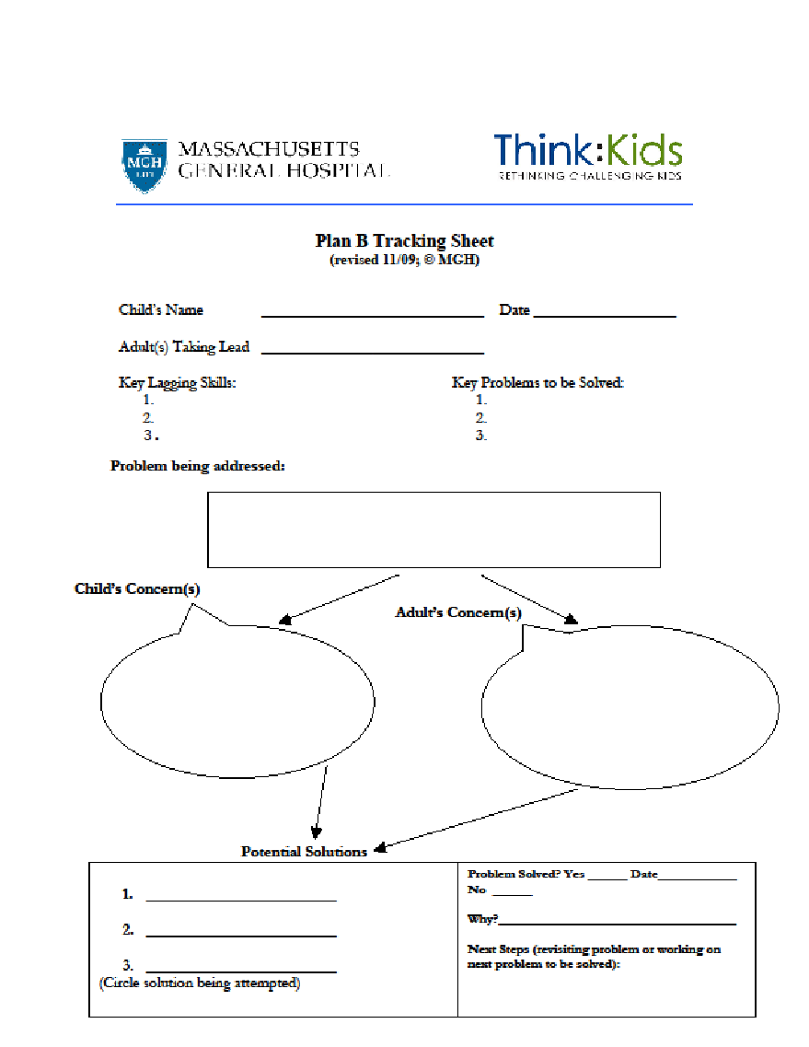

Slide 24
CPS Video
Discussion
https://www.youtube.com/watch?v=ygMWv9VesiQ&feature=youtu.be

