Slide 1
Give. Bring. Share.
Discipline and restraint policies

Slide 2
Table of Content
Statement of Policy
Purpose
Individuals and Entities Affected by This Policy
Exclusions
Responsibilities
Behavior Management
Physical Restraint Documentation
Physical Restraint Review
Behavior Support
Supportive Environment
Skill Development

Slide 3
Statement of Policy and Purpose
Statement of Policy
Purpose
Foster parents of Youth Unlimited Inc. will provide all children with opportunities to be successful in the home and in the community by using methods that recognize and reward positive behavior.
Youth Unlimited Inc. believes in a positive approach to discipline and is committed to providing an environment where children feel safe and comfortable.
Behavior management policies shall be followed to protect the safety of all children, foster parents and staff persons.
Foster parents and staff shall ensure that each child is provided with a positive model of acceptable behavior.
Children are encouraged to practice those skills that will allow them to resolve conflicts and have their needs met without the use of aggressive or destructive behaviors.
Notes:
This is a means of preventing behavioral difficulties between children and lessens the need for disciplinary action on the part of the foster parent and staff. When situations occur, which require intervention, foster parents and staff should provide children with clear explanations as to why specific behavior is inappropriate and help them to find an alternative behavior that fits within home guidelines.

Slide 4
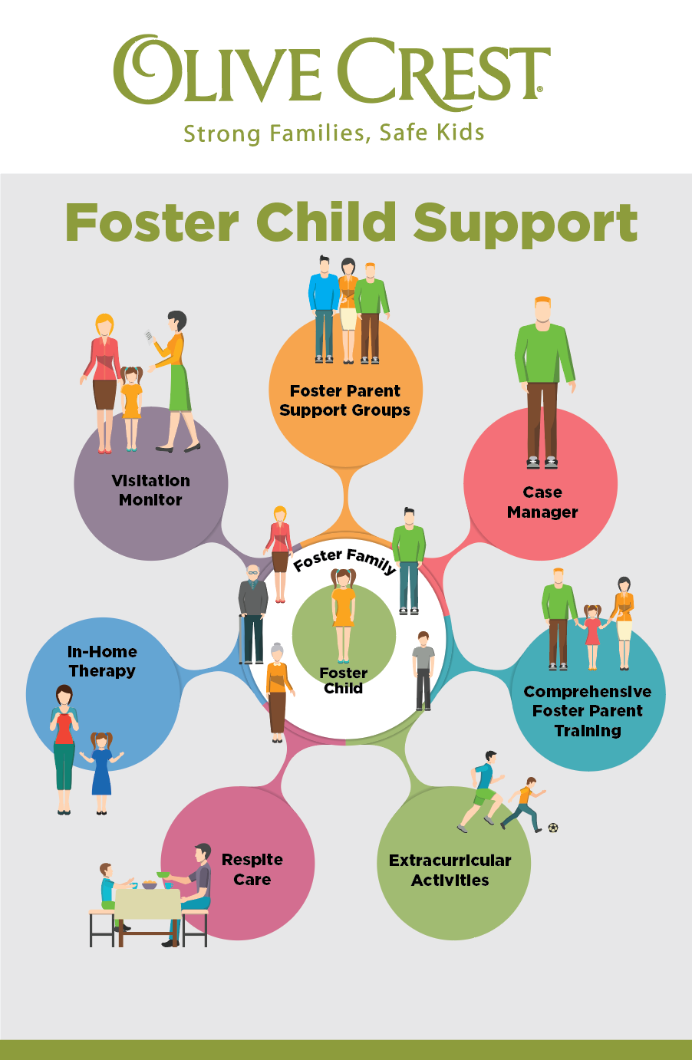
Individuals and Entities Affected by This Policy and Exclusions
Individuals and Entities Affected by this Policy Exclusions
Client
YUI Staff
Case Worker (guardian)
Foster parents
Discipline:
By Oregon Law, Youth Unlimited Inc. prohibits discipline that uses the following methods:
Spanking, hitting, or striking with an instrument.
Committing an act designed to humiliate, ridicule, or degrade a child in care or undermine the self-respect of a child in care.
Punishing a child in care in the presence of a group or punishment of a group for the behavior of one child in care
Depriving a child in care of food, clothing, shelter, bedding, rest, sleep, toilet access, or parental contact.
Assigning extremely strenuous exercise or work or requiring a child in care to spend prolonged time in one position likely to produce unreasonable discomfort.
Using physical restraint or seclusion as discipline.
Permitting or directing a child in care to punish another child in care.
Using any other kind of harsh punishment.
Denying a parent, guardian, or sibling the right to visit a child in care solely as a disciplinary measure against the child in care.
1984
VISIT
SHINRIN-YOKU
FOREST

Slide 5
Strong families, safe kids
Responsibilities
Foster home rules shall be:
Tailored to the developmental level of the child
Be short and simple
Be stated in a positive way and be used consistently
Foster parent or staff person Expectations:
Foster parent or staff will then redirect the child to activities that hold the child’s attention (the choice is made with the child).
Notes:
Foster Home Rules:
These guidelines revolve around concerns for the safety of all children.
If the behavior continues, the foster parent or staff person will consult with fellow staff members and/or the director to develop alternatives for helping the child gain acceptable control of his/her behavior.
Older children will be encouraged to set rules together. If a child is displaying persistent, unacceptable behavior, the foster parent/staff will take steps to help the child gain self-control.
Foster parent & Staff Expectations:
The goal is to help the child strengthen his/her skills of self-control. Separating the child from the group is a final step that would be taken after other measures have been tried. If the child can not resort to behavior that ensures his own and the safety of others in the foster home, and/or the smooth operation of the program; the legal guardian will then be contacted for next step planning.

Slide 6
Safe families,safe kids
Behavior Management
Non-violent crisis intervention:
All YUI proctor foster parents and staff are trained in the Oregon Intervention System (OIS): A non-violent crisis intervention during their Pre-Service Orientation Training.
"Physical Restraint"
Act of restricting a child in care's voluntary movement as an emergency measure in order to manage and protect the child in care or others from injury when no alternate actions are sufficient to manage the child in care's behavior.
Does not include temporarily holding a child in care to assist him or her or assure his or her safety, such as preventing a child in care from running onto a busy street.
The incident must be logged in an Incident Report Form and reported to the YUI case manager and the legal guardian; child welfare worker, parent, or probation officer within 1 hour after ensuring the safety of everyone involved in the incident.
The executive director must follow-up with the foster parent within 24 hours.
A copy of the incident report must be sent by the E.D. to the board president.
Notes:
Non-violent Crisis Intervention: Only YUI staff and proctor foster parents who have been trained in a nationally recognized non-violent crisis-intervention system, such as OIS, may use physical restraint and only when physical restraint is necessary as a last resort to prevent a child in care from inflicting harm to self or others.
Any use of physical restraint by a YUI staff member or proctor foster parent, if the member is not trained in a nationally recognized non-violent crisis intervention system, must also be reported to a Department licensing coordinator within one working day of occurrence.
For a child in care who has a documented physical condition that would contraindicate the use of a particular restraint, Youth Unlimited Inc. prohibits the application of a non-violent physical restraint, unless a qualified medical professional has previously and specifically authorized its use in writing for that child in care. Documentation of the authorization must be maintained in the child in care's record.

Slide 7
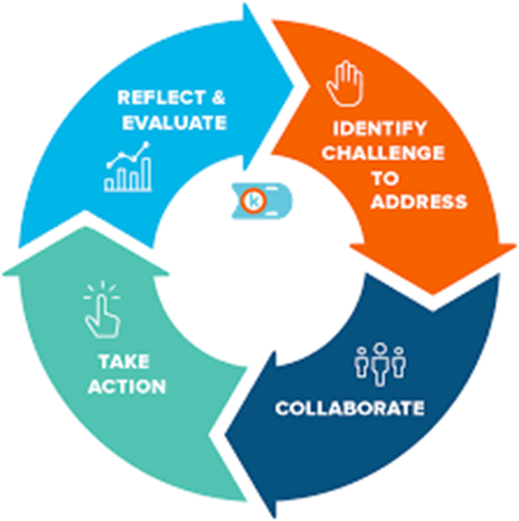
Youth Unlimited Inc.
Behavior Management

Slide 8
Safe families, safe kids
Physical Restraint Documentation And Review
Report Physical Restraint:
Include specific attempts to de-escalate the situation before using physical restraint
Length of time the physical restraint was applied.
Time the restraint started and the time it was terminated
Debriefing completed with the staff and child in care involved in the physical restraint, and documentation of a review by the executive director, program director, or designee.
Notes:
The policies of the child-caring agency must require a report on an incident report form of behavior that required the use of physical restraint.
The policies of the child-caring agency must require that whenever a physical restraint is used on a child in care more than two times in seven days, there is a review by the executive director, the director's designee, or a management team to determine the suitability of the program for the child in care, whether modifications to the child in care's plan are warranted, and whether staff need additional training in alternative therapeutic behavior management techniques. YUI will take appropriate action indicated by the review.

Slide 9
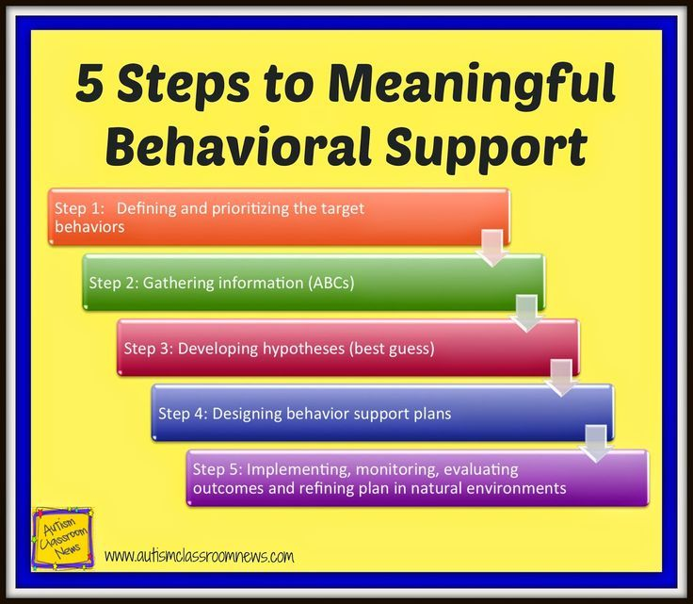
Behavior Support
Positive activities such as shooting hoops or journal writing can help children redirect excess energy or anger.
Challenging behaviors can often be redirected using active listening and verbal de-escalation techniques.
Early intervention with risky behaviors may be necessary to prevent further acting out and reduce risk of harm to the child or others.
All behavior change strategies selected must be appropriate to the child’s ability to understand; and
Greater objectivity and effectiveness may be gained by consulting with other team members in selecting a strategy.
Notes:
Adults may still provide effective guidance when they allow the child to make mistakes as part of the learning process; Occasionally ignore behavior; and Allow the child to learn by experiencing the natural consequences of the behavior.

Slide 10
A supportive environment ensures children get their needs met when they use socially acceptable behaviors. It reduces a child’s need to use problem behaviors to obtain an adult response.
Adults in a supportive environment:
Acknowledge the child’s abilities and accomplishments;
Notice what the child does right and encourage more of that
behavior;
Balance predictability and consistency with an ability to respond quickly to changes in the child’s life and behavior; and
Recognize stressful circumstances (such as poor sleep, hunger, illness, parental visits, or court dates) and make reasonable adjustments in expectations for the child.
Supportive Environment

Slide 11
Safe families, safe kids
Skills Development
Adults increase behavioral control skills in children by:
Explaining what is expected;
Redirecting ineffective behavior;
Offering choices;
Modeling how to negotiate and problem solve;
Supporting the child’s efforts to effectively control her own behavior;
Being aware of and managing their own responses to challenging behaviors;
Providing a daily structure which supports the child’s need for consistency;
Foster parent and child will develop a list of response options and matching the intensity of the adult response to the seriousness of the child’s behavior;
Giving consequences for unacceptable behavior;
Encouraging each child to be appropriately involved in school and community activities; and
Making sure each child has opportunities to form significant, positive friendships and family relationships.

