Slide 1
Trauma-informed care:
Understanding Childhood Trauma/ACES
Core Story of the Brain

Slide 2
Childhood trauma
How Childhood trauma affects the brain
1984
VISIT
SHINRIN-YOKU
ACE’s & ACE Study Trauma
FOREST
ACE’s Prevention & How To Care For a Youth With Trauma

Slide 3
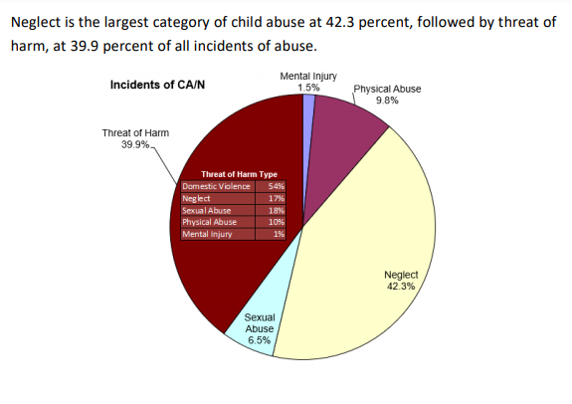
Abuse and Neglect
Childhood Trauma
What is trauma?
It’s an emotional response to a terrible event like an accident, rape or natural disaster. Immediately after the event, shock and denial are typical. Longer term reactions include unpredictable emotions, flashbacks, strained relationships and even physical symptoms like headaches or nausea. While these feelings are normal, some people have difficulty moving on with their lives
Most common trauma in foster children
.Threat of Harm
Neglect
Physical Abuse
What Neglect does to the brain

Slide 4
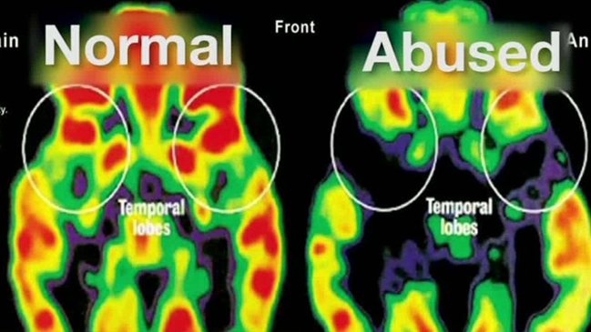
Brain images
How Childhood Trauma Effects Brain Development
4 Ways Childhood Trauma Changes a Child’s Brain and Body
Hormone level changes: Cortisol and adrenaline are the “stress hormones” that help a person react to a perceived threat or danger by directing blood flow to major muscle groups and bypassing the thinking part of the brain to activate the survival part.
Immune system changes: Through multiple organs, tissues, and cells, the immune system defends against infections, allergies, and inflammatory reactions.
Neurological changes: We are born with 100 billion neurons—brain nerve cells—which are almost all of the neurons we will ever have. The connections between neurons develop vision, hearing, language, and higher cognitive functioning.
Epigenetic changes: Epigenetics is the study of how your environment and experiences can alter which genes turn on and off, known as gene modification. For example, “you may be born with a capacity to be tall and confident, but if you are undernourished and abused as a child, you are likely to turn into a stunted and fearful adult instead,” according to Dr. John Launer.
Notes:
Watch video https://www.fosterclub.com/training/impact-separation-children-and-youth

Slide 5
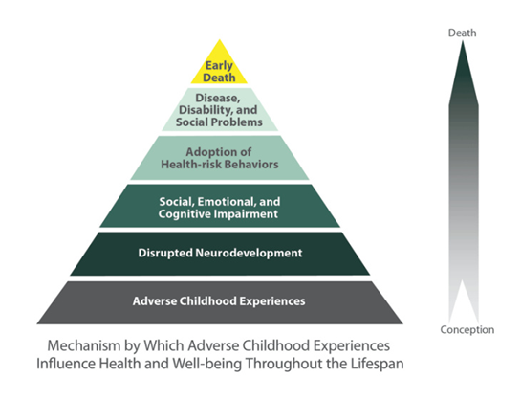
Childhood trauma
Adverse Childhood Experiences (ACE)
https://www.ted.com/talks/nadine_burke_harris_how_childhood_trauma_affects_health_across_a_lifetime?utm_campaign=tedspread&utm_medium=referral&utm_source=tedcomshare
The ACE Study has uncovered how ACEs are strongly related to development of risk factors for disease, and well-being throughout the life course.
ACEs are common across all populations. Almost two-thirds of study participants reported at least one ACE, and more than one in five reported three or more ACEs.

Slide 6
ACE Study
ACE Study: Types Of Trauma
Abuse
Emotional abuse: A parent, stepparent, or adult living in your home swore at you, insulted you, put you down, or acted in a way that made you afraid that you might be physically hurt.
Physical abuse: A parent, stepparent, or adult living in your home pushed, grabbed, slapped, threw something at you, or hit you so hard that you had marks or were injured.
Sexual abuse: An adult, relative, family friend, or stranger who was at least 5 years older than you ever touched or fondled your body in a sexual way, made you touch his/her body in a sexual way, attempted to have any type of sexual intercourse with you.
Household Challenges
Mother treated violently: Your mother or stepmother was pushed, grabbed, slapped, had something thrown at her, kicked, bitten, hit with a fist, hit with something hard, repeatedly hit for over at least a few minutes, or ever threatened or hurt by a knife or gun by your father (or stepfather) or mother’s boyfriend.
Substance abuse in the household: A household member was a problem drinker or alcoholic or a household member used street drugs.
Mental illness in the household: A household member was depressed or mentally ill or a household member attempted suicide.
Parental separation or divorce: Your parents were ever separated or divorced.
Incarcerated household member: A household member went to prison.
Neglect
Emotional neglect: Someone in your family helped you feel important or special, you felt loved, people in your family looked out for each other and felt close to each other, and your family was a source of strength and support.
Physical neglect: There was someone to take care of you, protect you, and take you to the doctor if you needed it2, you didn’t have enough to eat, your parents were too drunk or too high to take care of you, and you had to wear dirty clothes.

Slide 7
Pathways to healing
ACE Prevention and How To Care For A Child With Trauma
https://www.albertafamilywellness.org/resources/video/how-brains-are-built-core-story-of-brain-development
https://youtu.be/8gm-lNpzU4g
Make your child feel safe
Act calm.
Maintain routines as much as possible.
Help children enjoy themselves.
Pick good times to talk/redirect
Understand that children cope in different ways.
Actively Listen
Acknowledge/validate what your child is feeling
Don’t personalize youth’s behaviors

Slide 8
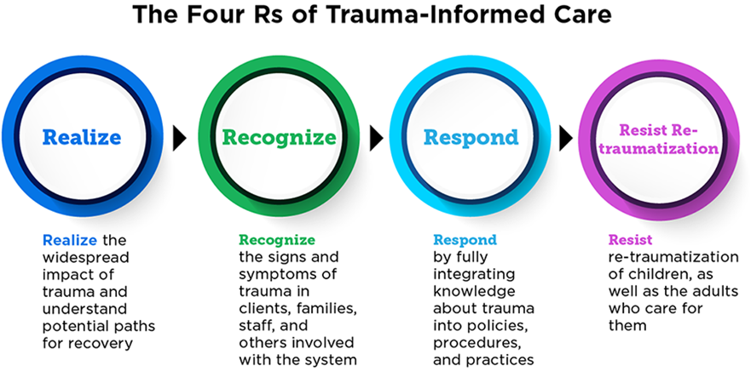
Trauma-informed Care
The primary re-framing question that trauma-informed care asks:
“What happened to you?” Instead of, “What’s wrong with you?”

